Slide 1

Freelance Job Board
Instructor:
Eng.Merna Mostafa
Team Members:
Ahmed Mahmoud
Sara Ashraf
Malak Mashaly

Slide 2
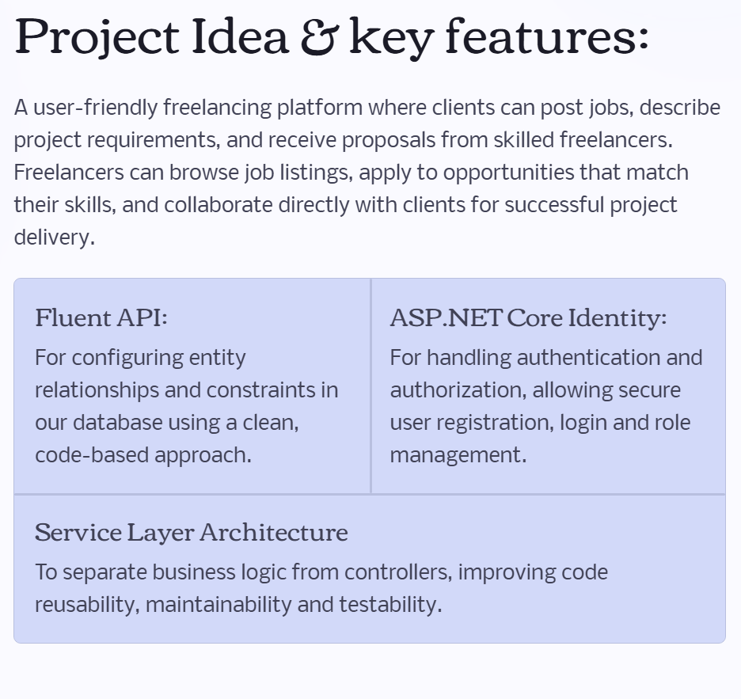
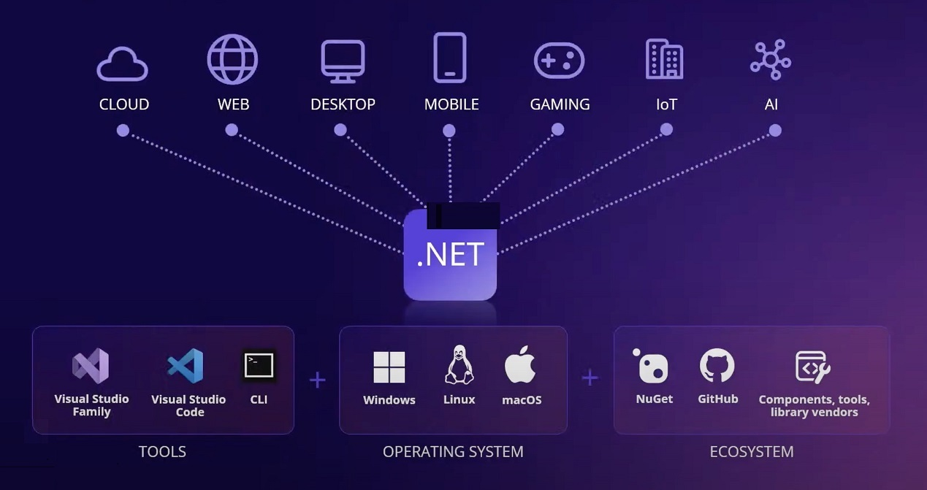

Slide 3
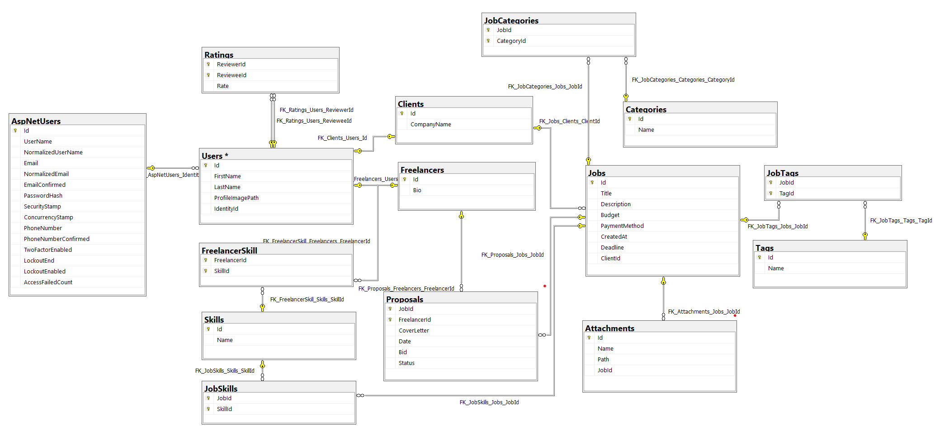
Our database structure: These are the models that define the entities and relationships in our MVC project.

Slide 4
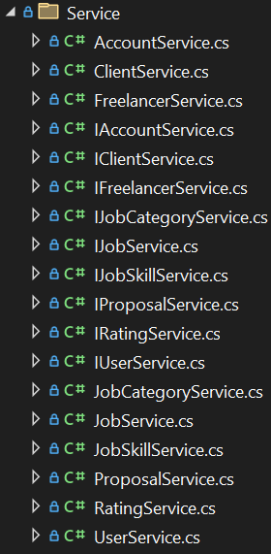
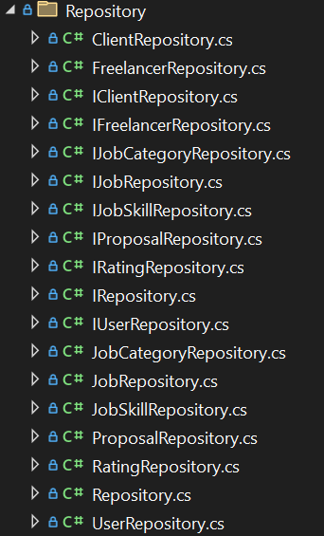
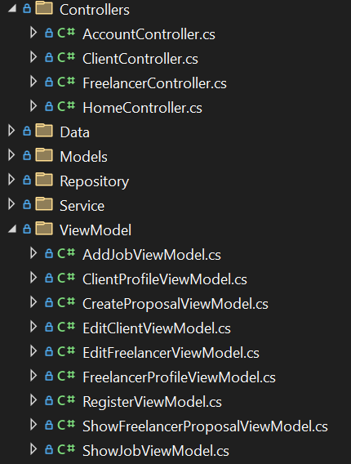
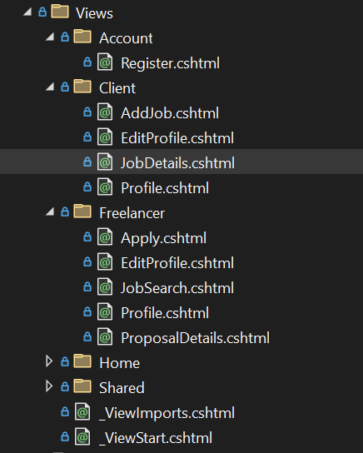
Here’s a quick overview of how our project is organized : The repositories, services, controllers, and views that make up the MVC architecture.

Slide 5
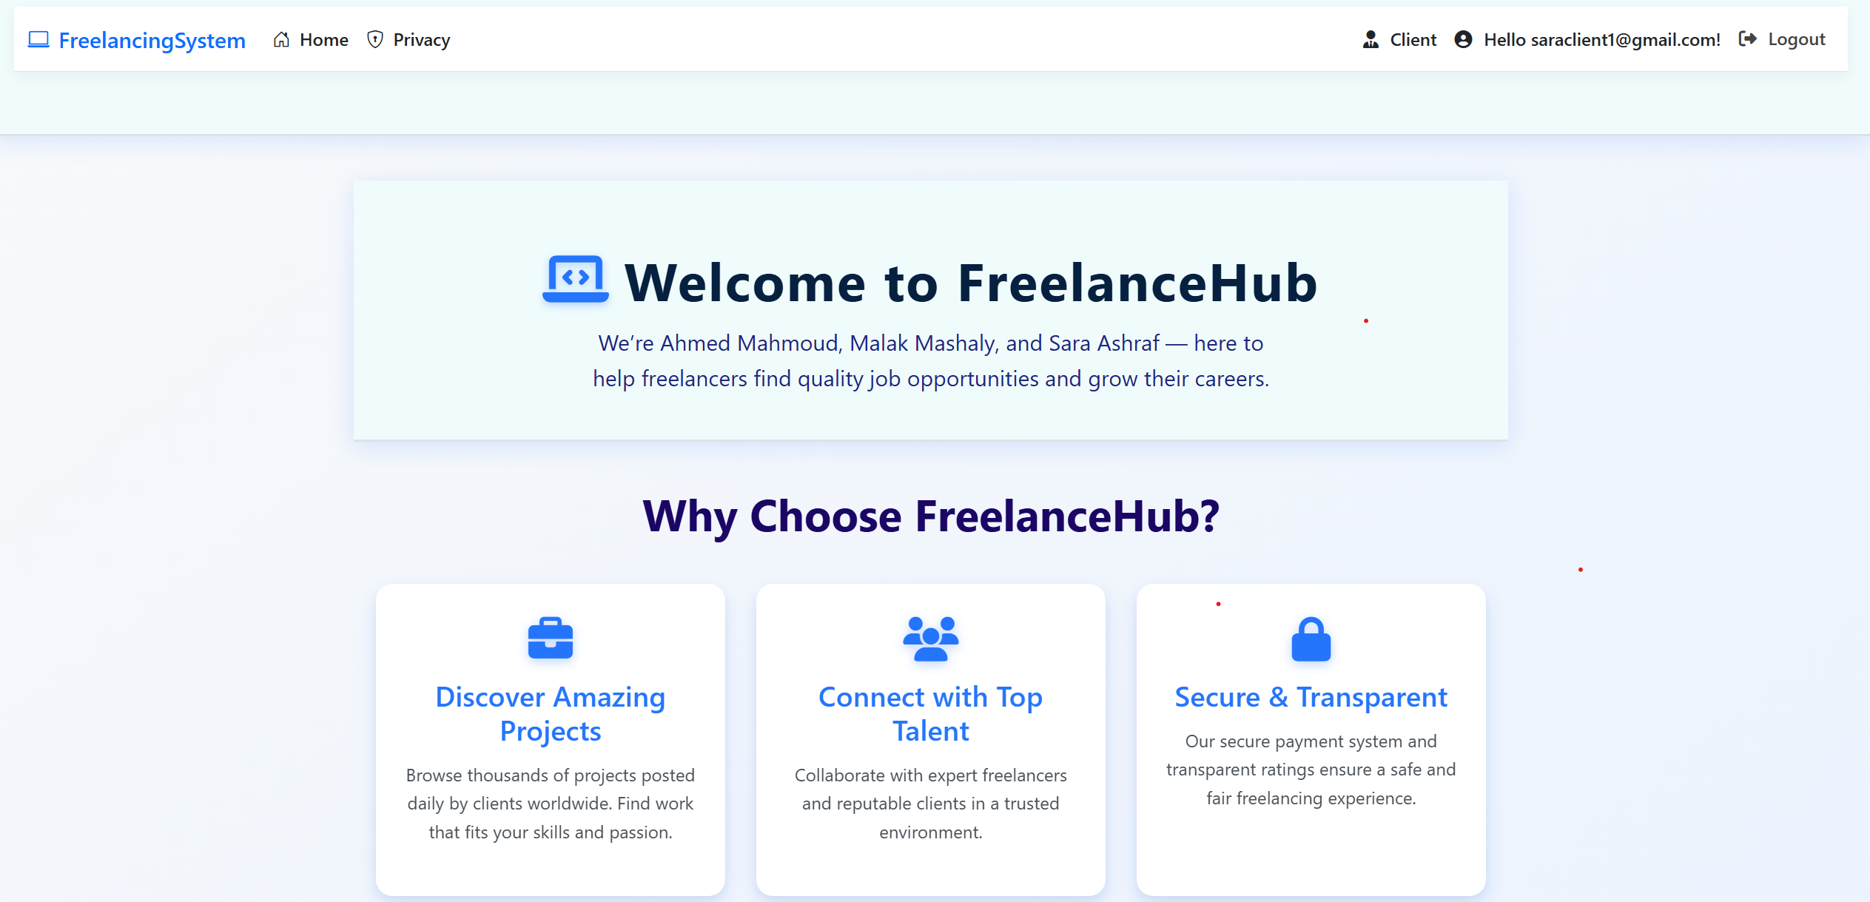
We invite you to test our system! This is a preview from our website:
And here’s the GitHub link to access the source code and run the project: https://github.com/ahmed-mahmoud15/Freelancing-System

